Slide 1
CAMPUS CONNECT
Presented By:
SHAIK KHASIM (210304124316)
MARREBOYINA PRABAKAR (210304124055)
MORAMPUDI JAGADEESH (210304124083)
TAMMISETTY CHAITANYA (210304124361)
Guided By:
SHIVANGI GANDHI
ASSISTANT PROFESSOR
CSE DEPARTMENT
PIET, PARUL UNIVERSITY
Internal Project Presentation 2024

Slide 2
Content
Introduction
Background study (Research Paper Summary in Table form – Format shared in the next slide)
Objectives of the Project
What is exactly to be done?
Why is this project selected?
Where is the project is helpful?
When it can be implemented?
Who will be benefitted?
Project Team : Roles and Responsibilities
Schedule
UML Diagrams
Advantages of the System
Limitations of the System
Conclusion
Future Work
References

Slide 3
INTRODUCTION
Campus Connect is a web application designed to revolutionize communication and collaboration within university or college campuses. With its centralized platform, students can effortlessly stay updated on campus events, seamlessly create and manage study groups, and conveniently engage in a local marketplace for textbook transactions. This innovative application aims to foster a connected campus community, enhancing the overall student experience and academic success.
Additional Points: Seamless Communication: Campus Connect facilitates seamless communication among students, allowing them to exchange messages, share resources, and coordinate activities effortlessly.
User-Centric Design: With a user-friendly interface and intuitive features, Campus Connect prioritizes the needs and preferences of students, ensuring a seamless and enjoyable user experience.

Slide 4
Research Papers studied
Sr. number | Paper tittle | publisher | year | Take-away points
1. | Smart Campus | IEEE | 2024 | Improve service for the campus community
2. | Internet of behaviours | IEEE | 2023 | Network to predict academic performance of student in campus
3. | The nature of university partnership | Green | 2024 | Benefits of university partnership
4. | Design campus connect | Mane | 2023 | Solving student problems
5. | Advance education through metaverse | IEEE | 2023 | Virtual class for students
6. | Application of IOT | IEEE | 2022 | VR technology in campus
7. | Development of university campus | Gryzun | 2023 | Improve university features
8. | Making of smart campus | Mark limb | 2023 | Improve domains of smart campus
9. | Designing chatbots | Yu Chen | 2022 | Chatbots in campus
10. | Connectedness within campus | Ryan | 2023 | Fostering campus could improve student learning outcomes

Slide 5
Research Papers studied
Sr. number | Paper Tittle | Publisher | Year | Take away-points
11. | Campus connections program | Hal | 2022 | Improving academics library
12. | Smart campus tool | Bart Valks | 2023 | Smart tool is used of international universities
13. | Connecting students | Henry | 2022 | Improve connections with students in campus
14. | Virtual campus connection | Swami | 2019 | Provide e-learning education
15. | Connecting across campus | Mark D | 2019 | Improve connections
16. | Campus connect | Heiko | 2023 | E-learning infrastructure
17. | Application for mobile communication | Haffey | 2022 | Implement application
18. | Making the connections | Barry j | 2023 | Collaborating connections
19. | Smart campus management | Tiwari | 2020 | Making smart campus
20. | Smart connected campus | Anju | 2019 | Providing all resources

Slide 6
OBJECTIVE OF CAMPUS CONNECT
Users: Students, faculty, and staff accessing features like event announcements and study group formation.
Events: Activities within the campus, including lectures and social gatherings, managed through the application.
Study Groups: Collaborative groups formed by users for academic purposes like studying and discussion.
Textbooks: Academic materials available for sale or exchange within the campus marketplace feature.
Messages: Communication exchanges, including direct messages and notifications, facilitated within the application.

Slide 7
Project Team : Roles and Responsibilities
Sr. no | Team member | Enrollment number | Role | Responsibility
1. | SHAIK KHASIM | 210304124316 | Team lead, testing backend development | Team Lead: Oversees the project, coordinates team members, and ensures goals are met on time. Testing: Responsible for conducting tests to ensure the software meets quality standards.
2. | MARREBOYINA PRABAKAR | 210304124055 | Front end developer | Front-end development: create user-friendly interfaces to enhance user experience , designing applications by using flutter.
3. | MORAMPUDI JAGADEESH | 210304124083 | Backend developer UI/UX designer | Backend Development: Handles server-side logic, database interactions, and ensures performance
4. | TAMMISETTY CHAITANYA | 210304123361 | Database management | A database administrator (DBA) responsible for managing organization database.

Slide 8
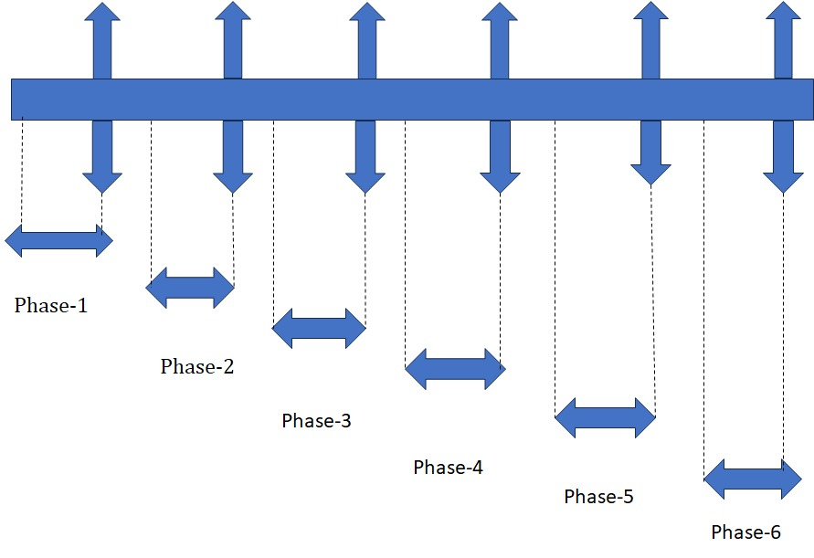
Time Line Chart - Schedule
March/April April/May May/June July/August August/sept October/Novem

Slide 9
Time Line Chart - Schedule
SR.NUMBER
PHASES
ROLE
TI
SR.NUMBER | PHASES | ROLE | TIME
1. | PHASE-1 | FULL IMPLEMENTATION OF FRONT END | MARCH & APRIL
2. | PHASE-2 | MODEL DEVELOPMENT (HALF) | APRIL & MAY
3. | PHASE-3 | MODEL DEVELOPMENT (FULL) | MAY & JUNE
4. | PHASE-4 | BACKEND INTEGRATION WITH THE MODEL AND FRONT END | JUALY & AUGUST
5. | PHASE-5 | DTA BASE INTEGRATION WITH FRONTEND | AUGUST & SEPTEMBER
6. | PHASE-6 | MODEL TESTING & PRESENTATION | OCTOBER & NOVEMBER

Slide 10
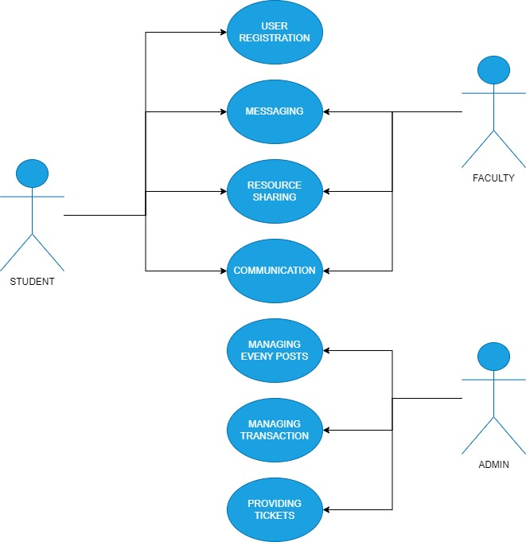
UML Diagrams USE CASE DIAGRAM:

Slide 11
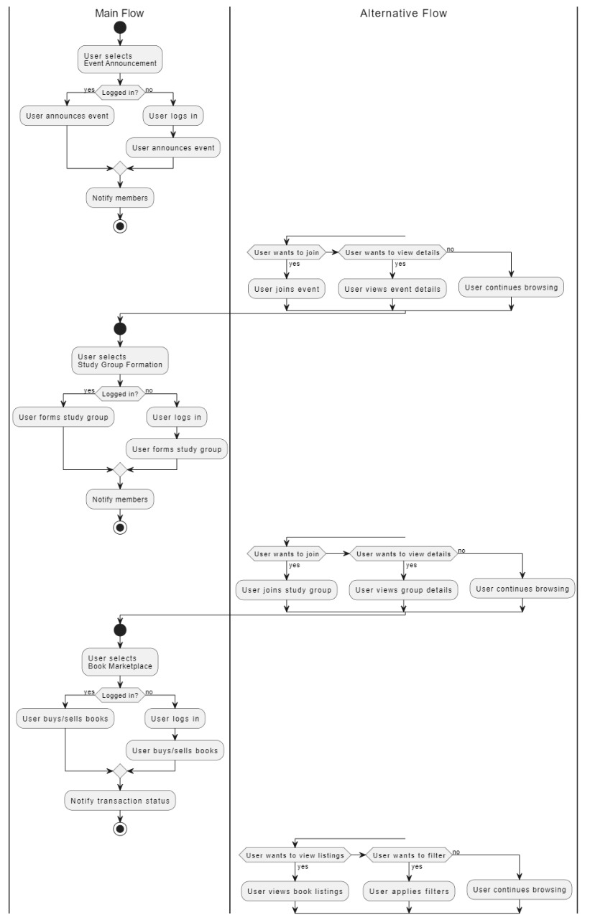
ACTIVITY DIAGRAM:

Slide 12
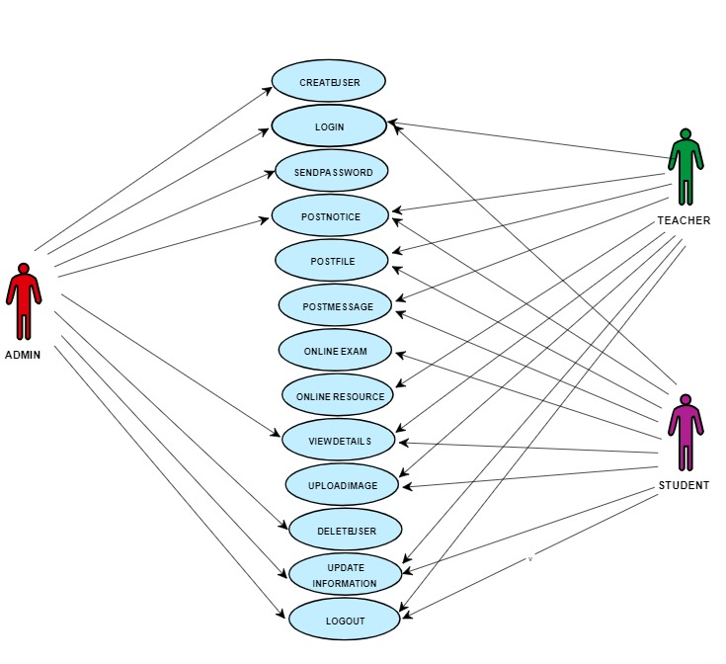
FLOW CHART:

Slide 13
Advantages of the System
Enhanced Communication: Campus Connect provides a centralized platform for seamless communication among students, faculty, and staff, fostering collaboration and engagement within the campus community.
Improved Collaboration: The application facilitates the formation of study groups and coordination of academic activities, enabling students to collaborate effectively on coursework, projects, and study sessions.
Convenient Access to Resources: With features like event announcements and a local marketplace for textbooks, Campus Connect offers students easy access to relevant information and resources, enhancing their academic experience.

Slide 14
Limitations of the System
Digital Divide: Not all students may have access to smartphones or reliable internet connectivity, limiting the reach and effectiveness of Campus Connect among certain demographics.
Technical Issues: The reliance on technology introduces the risk of technical glitches, server downtimes, or compatibility issues with different devices and operating systems, potentially disrupting user experience.
Privacy Concerns: The collection and storage of personal data within Campus Connect raise privacy concerns, necessitating robust data protection measures to safeguard sensitive information from unauthorized access or misuse.
Adoption Challenges: Encouraging widespread adoption of Campus Connect among students, faculty, and staff may face resistance due to unfamiliarity with technology, reluctance to adapt to new systems, or competing preferences for communication channels.
Limited Functionality: While Campus Connect offers features for communication, collaboration, and resource sharing, it may lack certain functionalities or integrations desired by users, leading to gaps in meeting specific needs or preferences.

Slide 15
Conclusion
In conclusion, Campus Connect represents a significant advancement in enhancing communication and collaboration within university and college campuses. By providing a centralized platform for students, faculty, and staff to stay informed about events, form study groups, and engage in textbook transactions, the system fosters a vibrant and connected campus community. Despite potential limitations such as technical challenges and privacy concerns, the benefits of improved communication, collaboration, and resource accessibility outweigh the drawbacks. With continued development and refinement, Campus Connect holds the potential to revolutionize the campus experience, contributing to enhanced academic success and student engagement.

Slide 16
Future Work
Developing Frontend
Model Development
Backend Integration With The Model
Database Integration Frontend And Backend
Model Testing
Presenting The Project

Slide 17
References:
Reference 1-The Nature of School-University Partnerships
Link: https://link.springer.com/chapter/10.1007/978-981-99-8838-9_2
Reference 2-Connectedness within the Statistics Classroom
Link: https://journals.sagepub.com/doi/abs/10.1177/00986283211070843
Reference 3- The Making of Smart Campus
Link: https://www.mdpi.com/2219844
Reference 4-Development of the information system for navigation in modern university campus
Link: https://acnsci.org/journal/index.php/cte/article/view/566
Reference 5-Design and Implementation of Campus Connect
Link: https:https://www.researchgate.net/profile/Sulakshana-Mane-4/publication/374631697_IJSRDV4I11043/links/6527c952bc063850eab9020f/IJSRDV4I11043.pdf

Slide 18
References:
Reference 6-University of Central Florida's Campus Connections Program
Link: https://doi.org/10.1108/00907321211254652
Reference 7-Smart campus tools 2.0 exploring the use of real-time space use measurement at universities and organizations
Link: https://doi.org/10.1108/F-11-2018-0136
Reference 8-Reaching out: connecting students to their personal librarian
Link: https://doi.org/10.1108/00907321211254661
Reference 9-Virtual Campus Connection For E-learning
Link: https://www.neliti.com/publications/428669/virtual-campus-connection-for-e-learning
Advance Education Through Metaverse
Link: https://ieeexplore.ieee.org/abstract/document/10415252

Slide 19
References:
Reference 11- Artificial Intelligence (AI) Student Assistants in the Classroom: Designing Chatbots to Support Student Success
Link: https://link.springer.com/article/10.1007/s10796-022-10291-4
Reference 13- Internet of behavoiur
Link: https://doi.org/10.1109/JIOT.2023.3247594
Reference 14- Application of IOT
Link: https://ieeexplore.ieee.org/abstract/document/9091187
Reference 15- Connecting across campus
Link: https://dl.acm.org/doi/abs/10.1145/1734263.1734280
Reference 16-CampusConnect
Link:10.1109/EDUCON.2014.6826080

Slide 20
References:
References 17- Building an Application for Mobile Communication
Link: http://hdl.handle.net/10920/30429
Reference 18- Making the connection: Successful cross campus collaboration among student
Link: 10.1109/FIE.2016.7757614
Reference 19- Smart Campus Management with Advanced Learning Management System
Link: 10.1109/NPSC49263.2020.9331898
Reference 20- Smart connected campus
Link: 0.1109/ICICICT1.2017.8342808

Slide 21


